Slide 1
DataBase intro

Slide 2

PLAN
Intro. Database Core
Definition
SQL database
Sockets
Conclusion

Slide 3


Definition
Database
In computing, a database is an organized collection of data stored and accessed electronically.
A database management system (DBMS) is the software that interacts with end users, applications, and the database itself to capture and analyze the data.

Slide 4

Relational database
A relational database is a collection of information that organizes data in predefined relationships where data is stored in one or more tables (or "relations") of columns and rows, making it easy to see and understand how different data structures relate to each other

Slide 5
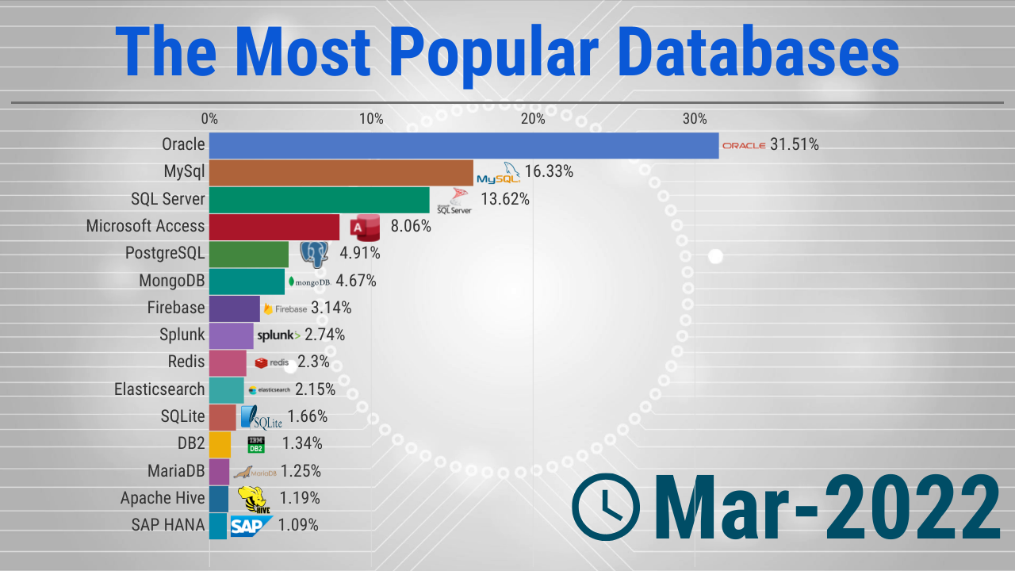
DBMS

Slide 6

SQL
Some of The Most Important SQL Commands
CREATE DATABASE - создает новую базу данных
CREATE TABLE - Создание новой таблицы
SELECT - Извлекает данные из базы данных
UPDATE - обновляет данные в базе данных
DELETE - Удаление данных из базы данных
INSERT INTO - Вставка новых данных в базу данных
DROP TABLE - Удаление таблицы
DROP DATABASE - Удаление базы данных

Slide 7
CREATE DATABASE
The CREATE DATABASE statement is used to create a new SQL database.
Syntax:
CREATE DATABASE databasename
Example:
CREATE DATABASE testDB;

Slide 8
CREATE TABLE
The CREATE TABLE statement is used to create a new table in a database.
Syntax:
CREATE TABLE table_name ( column1 datatype, column2 datatype, column3 datatype, .... );
Example:
CREATE TABLE Persons ( PersonID int, LastName varchar(255), FirstName varchar(255), Address varchar(255), City varchar(255) );

Slide 9
Select
The SQL SELECT Statement
The SELECT statement is used to select data from a database.
The data returned is stored in a result table, called the result-set.
Syntax:
SELECT column1, column2, ... FROM table_name;
Example:
The following SQL statement selects the "CustomerName" and "City" columns from the "Customers" table:
CustomerID | CustomerName | ContactName | Address | City | PostalCode | Country
1 | Alfreds Futterkiste | Maria Anders | Obere Str. 57 | Berlin | 12209 | Germany
2 | Ana Trujillo Emparedados y helados | Ana Trujillo | Avda. de la Constitución 2222 | México D.F. | 05021 | Mexico
3 | Antonio Moreno Taquería | Antonio Moreno | Mataderos 2312 | México D.F. | 05023 | Mexico
4 | Around the Horn | Thomas Hardy | 120 Hanover Sq. | London | WA1 1DP | UK
5 | Berglunds snabbköp | Christina Berglund | Berguvsvägen 8 | Luleå | S-958 22 | Sweden
SELECT CustomerName, City FROM Customers;
CustomerName | City
Alfreds Futterkiste | Berlin
Ana Trujillo Emparedados y helados | México D.F.
Antonio Moreno Taquería | México D.F.
Around the Horn | London
Berglunds snabbköp | Luleå

Slide 10
UPDATE
The SQL UPDATE Statement
The UPDATE statement is used to modify the existing records in a table.
Syntax:
UPDATE table_name SET column1 = value1, column2 = value2, ... WHERE condition;
Example:
The following SQL statement updates the first customer (CustomerID = 1) with a new contact person and a new city.
CustomerID | CustomerName | ContactName | Address | City | PostalCode | Country
1 | Alfreds Futterkiste | Maria Anders | Obere Str. 57 | Berlin | 12209 | Germany
2 | Ana Trujillo Emparedados y helados | Ana Trujillo | Avda. de la Constitución 2222 | México D.F. | 05021 | Mexico
3 | Antonio Moreno Taquería | Antonio Moreno | Mataderos 2312 | México D.F. | 05023 | Mexico
4 | Around the Horn | Thomas Hardy | 120 Hanover Sq. | London | WA1 1DP | UK
5 | Berglunds snabbköp | Christina Berglund | Berguvsvägen 8 | Luleå | S-958 22 | Sweden
UPDATE Customers SET ContactName = 'Alfred Schmidt', City= 'Frankfurt' WHERE CustomerID = 1;
You have made changes to the database. Rows affected: 1
1 | Alfreds Futterkiste | Alfred Schmidt | Obere Str. 57 | Frankfurt | 12209 | Germany
2 | Ana Trujillo Emparedados y helados | Ana Trujillo | Avda. de la Constitución 2222 | México D.F. | 05021 | Mexico
3 | Antonio Moreno Taquería | Antonio Moreno | Mataderos 2312 | México D.F. | 05023 | Mexico

Slide 11
INSERT INTO
The SQL INSERT INTO Statement
The INSERT INTO statement is used to insert new records in a table.
Syntax:
1. Specify both the column names and the values to be inserted:
INSERT INTO table_name (column1, column2, column3, ...) VALUES (value1, value2, value3, ...);
2. If you are adding values for all the columns of the table, you do not need to specify the column names in the SQL query. However, make sure the order of the values is in the same order as the columns in the table. Here, the INSERT INTO syntax would be as follows:
INSERT INTO table_name VALUES (value1, value2, value3, ...);

Slide 12
INSERT INTO
Example:
CustomerID | CustomerName | ContactName | Address | City | PostalCode | Country
89 | White Clover Markets | Karl Jablonski | 305 - 14th Ave. S. Suite 3B | Seattle | 98128 | USA
90 | Wilman Kala | Matti Karttunen | Keskuskatu 45 | Helsinki | 21240 | Finland
91 | Wolski | Zbyszek | ul. Filtrowa 68 | Walla | 01-012 | Poland
INSERT INTO Customers (CustomerName, ContactName, Address, City, PostalCode, Country) VALUES ('Cardinal', 'Tom B. Erichsen', 'Skagen 21', 'Stavanger', '4006', 'Norway');
You have made changes to the database. Rows affected: 1
CustomerID | CustomerName | ContactName | Address | City | PostalCode | Country
89 | White Clover Markets | Karl Jablonski | 305 - 14th Ave. S. Suite 3B | Seattle | 98128 | USA
90 | Wilman Kala | Matti Karttunen | Keskuskatu 45 | Helsinki | 21240 | Finland
91 | Wolski | Zbyszek | ul. Filtrowa 68 | Walla | 01-012 | Poland
92 | Cardinal | Tom B. Erichsen | Skagen 21 | Stavanger | 4006 | Norway

Slide 13
Delete
The SQL DELETE Statement
The DELETE statement is used to delete existing records in a table.
Syntax:
DELETE FROM table_name WHERE condition;
Example:
CustomerID | CustomerName | ContactName | Address | City | PostalCode | Country
1 | Alfreds Futterkiste | Maria Anders | Obere Str. 57 | Berlin | 12209 | Germany
2 | Ana Trujillo Emparedados y helados | Ana Trujillo | Avda. de la Constitución 2222 | México D.F. | 05021 | Mexico
3 | Antonio Moreno Taquería | Antonio Moreno | Mataderos 2312 | México D.F. | 05023 | Mexico
DELETE FROM Customers WHERE CustomerName='Alfreds Futterkiste';
CustomerID | CustomerName | ContactName | Address | City | PostalCode | Country
2 | Ana Trujillo Emparedados y helados | Ana Trujillo | Avda. de la Constitución 2222 | México D.F. | 05021 | Mexico
3 | Antonio Moreno Taquería | Antonio Moreno | Mataderos 2312 | México D.F. | 05023 | Mexico

Slide 14
DROP Table
The SQL DROP TABLE Statement
The DROP TABLE statement is used to drop an existing table in a database.
Syntax:
DROP TABLE table_name; - SQL statement drops the existing table
TRUNCATE TABLE table_name; - The TRUNCATE TABLE statement is used to delete the data inside a table, but not the table itself.
Example:
DROP TABLE Customers
TRUNCATE TABLE Customers

Slide 15
DROP DATABASE
The SQL DROP DATABASE Statement
The DROP DATABASE statement is used to drop an existing SQL database.
Syntax:
DROP DATABASE databasename;
Example:
DROP DATABASE testDB;

Slide 16
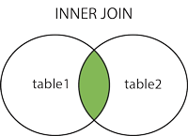
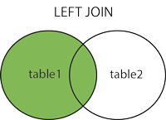
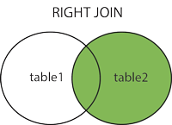
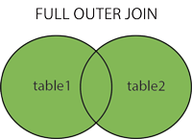
Different Types of SQL JOINs
(INNER) JOIN: Returns records that have matching values in both tables
LEFT (OUTER) JOIN: Returns all records from the left table, and the matched records from the right table
RIGHT (OUTER) JOIN: Returns all records from the right table, and the matched records from the left table
FULL (OUTER) JOIN: Returns all records when there is a match in either left or right table

Slide 17
INNER Join
SQL JOIN
A JOIN clause is used to combine rows from two or more tables, based on a related column between them.
OrderID | CustomerID | OrderDate
10308 | 2 | 1996-09-18
10309 | 37 | 1996-09-19
10310 | 77 | 1996-09-20
CustomerID | CustomerName | ContactName | Country
1 | Alfreds Futterkiste | Maria Anders | Germany
2 | Ana Trujillo Emparedados y helados | Ana Trujillo | Mexico
3 | Antonio Moreno Taquería | Antonio Moreno | Mexico

Slide 18
Join
Example:
SELECT Orders.OrderID, Customers.CustomerName, Orders.OrderDate FROM Orders INNER JOIN Customers ON Orders.CustomerID=Customers.CustomerID;
OrderID | CustomerName | OrderDate
10308 | Ana Trujillo Emparedados y helados | 9/18/1996
10365 | Antonio Moreno Taquería | 11/27/1996
10383 | Around the Horn | 12/16/1996
10355 | Around the Horn | 11/15/1996
10278 | Berglunds snabbköp | 8/12/1996

Slide 19
Join Left
Example:
Book ID | Book Name
3 | Hobbit
2 | Game Of Thrones
3 | The Lord of the Rings
4 | The Chronicles of Narnia
Author ID | Author Name
1 | Joanne Rowling
2 | George Martin
3 | J. R. R. Tolkien
SELECT * FROM Authors LEFT JOIN Books
ON Authors.AuthorID = Books.BookID
Authors.AuthorID | Authors.AuthorName | Books.BookID | Books.BookName
1 | Joanne Rowling | NULL | NULL
2 | George Raymond Martin | 2 | Game Of Thrones
3 | J. R. R. Tolkien | 3 | Hobbit
3 | J. R. R. Tolkien | 3 | The Lord of the Rings

Slide 20
Right join
Example:
Author ID | Author Name
1 | Joanne Rowling
2 | George Martin
3 | J. R. R. Tolkien
Book ID | Book Name
3 | Hobbit
2 | Game Of Thrones
3 | The Lord of the Rings
4 | The Chronicles of Narnia
SELECT * FROM Authors RIGHT JOIN Books
ON Authors.AuthorID = Books.BookID
Authors.AuthorID | Authors.AuthorName | Books.BookID | Books.BookName
3 | J. R. R. Tolkien | 3 | Hobbit
1 | George Martin | 1 | Game Of Thrones
3 | J. R. R. Tolkien | 3 | The Lord of the Rings
NULL | NULL | 4 | The Chronicles of Narnia

Slide 21
FULL Join
Example:
Author ID | Author Name
1 | Joanne Rowling
2 | George Martin
3 | J. R. R. Tolkien
Book ID | Book Name
3 | Hobbit
2 | Game Of Thrones
3 | The Lord of the Rings
4 | The Chronicles of Narnia
SELECT * FROM Authors FULL JOIN Books
ON Authors.AuthorID = Books.BookID
Authors.AuthorID | Authors.AuthorName | Books.BookID | Books.BookName
1 | Joanne Rowling | NULL | NULL
2 | George Raymond Martin | 2 | Game Of Thrones
3 | J. R. R. Tolkien | 3 | Hobbit
3 | J. R. R. Tolkien | 3 | The Lord of the Rings
NULL | NULL | 4 | The Chronicles of Narnia

Slide 22
Python DB API
>>> import psycopg2
# Подключение к существующей базе
>>> conn = psycopg2.connect("dbname=test user=postgres")
# Open a cursor to perform database operations
>>> cur = conn.cursor()
# Выполнение SQL запроса: создает новую базу
>>> cur.execute("CREATE TABLE test (id serial PRIMARY KEY, num integer, data varchar);")
# Pass data to fill a query placeholders and let Psycopg perform
# the correct conversion (no more SQL injections!)
>>> cur.execute("INSERT INTO test (num, data) VALUES (%s, %s)", ... (100, "abc'def"))
# Query the database and obtain data as Python objects
>>> cur.execute("SELECT * FROM test;")
>>> cur.fetchone() (1, 100, "abc'def")
# Make the changes to the database persistent
>>> conn.commit()
# Close communication with the database
>>> cur.close()
>>> conn.close()
Psycopg - это самая популярная библиотека для PostgreSQL в языке программирования python.
С помощью метода connect() создается подключение к экземпляру базы данных PostgreSQL
базой данных можно взаимодействовать с помощью класса cursor
- С помощью метода execute объекта cursor можно выполнить любую операцию или запрос к базе данных.
Результаты запроса можно получить с помощью fetchone(), fetchmany(), fetchall().
сохранять изменения в базу данных после успешного выполнения операции базы данных.
Закрытие курсора и подключения

Slide 23

TRANSACTION
Transactions are a fundamental concept of all database systems. The essential point of a transaction is that it bundles multiple steps into a single, all-or-nothing operation. The intermediate states between the steps are not visible to other concurrent transactions, and if some failure occurs that prevents the transaction from completing, then none of the steps affect the database at all.
COMMIT
EXECUTE
BEGIN

Slide 24

ACID
A Atomicity — Атомарность
C Consistency — Согласованность
I Isolation — Изолированность
D Durability — Надёжность

Slide 25



Sockets
HELLO!
Sockets

Slide 26
SOCKETS
EXAMPLE
Server
User
import socket
socket_socket = socket.socket() port = 6666 socket_socket.bind(('', port)) socket_socket.listen(1) conn, addr = socket_socket.accept() print('connected:', addr) while True: data = conn.recv(1024) if not data: break conn.send(data.upper()) conn.close()
import socket sock = socket.socket() sock.connect(('localhost', 6666)) data = 'hello world' sock.send(data.encode()) data = sock.recv(1024) sock.close() print(data)

Slide 27
Thank YOU!

